Slide 1

Prepaid Electricity Token System
Kyambogo University | Dept. of Biomedical & Mechatronics Engineering. Group 4 | TEMB 1202: Computing II

Slide 2
Table 1: Group 4
Name | Registration Number
BUKENYA JOHN MATHIAS | 25/U/BIO/025/GV
SSEKYANZI EDRINE ALLAN | 25/U/BIO/030/GV
NAMBATYA BUSHIRAT | 25/U/BIO/01405/PD
MWESIGWA ELLY | 25/U/BIO/01402/PD

Slide 3
Abstract
This project presents a C-based software interface designed to manage electricity utility records and automated token purchases. The system ensures high accuracy in billing using structured data and modular programming techniques to handle customer registration, authentication, and service fee deductions.

Slide 4
Project Overview
The Problem
Manual electricity management is prone to errors, data loss, and tracking inefficiencies. Our system automates registration, token purchasing, and usage monitoring.
Key Features
Secure Authentication
CRUD Customer Management
Automated Category-based Billing
Low Balance Alert

Slide 5
Technical Architecture
C Structures: Used to group related data types (Name, Meter, Category, Units) into a single database entry.
Storage: An array of structures handles up to 100 customer records efficiently.
Control Flow: A while(1) loop manages a menu-driven interface, allowing continuous operation and switch to control the users choices.

Slide 6
Defined Utility Rates
Category | Rate (UGX/kWh)
Domestic | 700
Commercial | 900
Industrial | 600
Service Fee | 1000

Slide 7
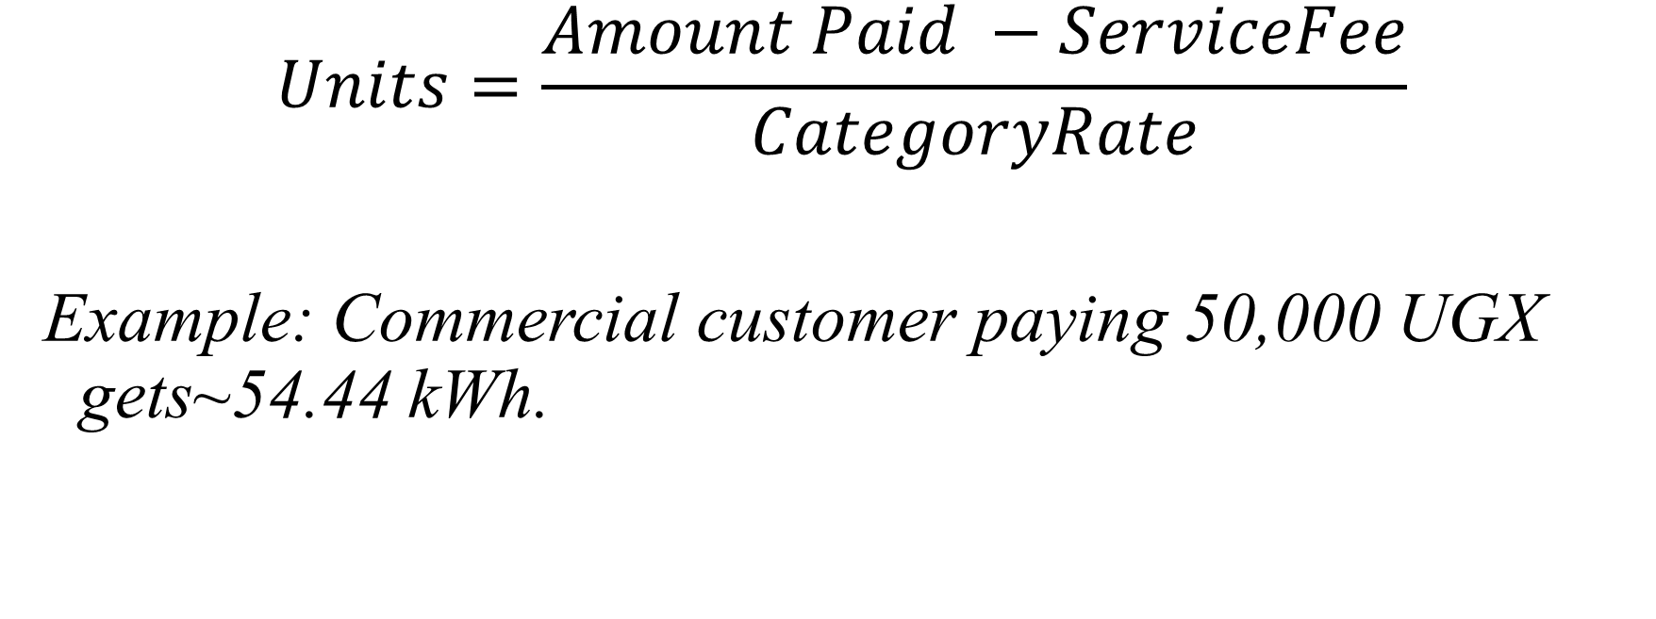
Billing Logic
$$Units=\frac{Amount Paid −ServiceFee}{CategoryRate}$$
Example: Commercial customer paying 50,000 UGX gets~54.44 kWh.

Slide 8
Technical Challenges
Managing array volatility (data is lost during termination)
Mastering strcmp for authentication logic
Precision management in category-based r ate
Input validation to ensure database integrity.
Intergrating logic with the LaTex reporting framework

Slide 9
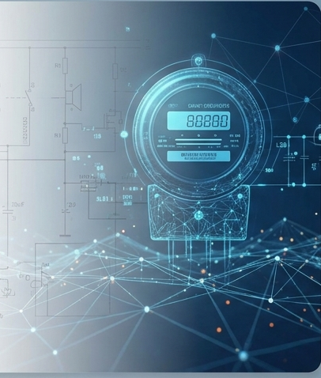
Conclusion
The Prepaid Electricity Token System successfully demonstrates structured programming concepts in C. It provides a robust, modular foundation for utility management, with future potential for file I/O integration for persistent storage.

